Slide 1
Local Restorative Practices
Prince George
Urban Aboriginal Justice Society

Slide 2
Introduction
My name is Vahid Mathiscyk
Justice Worker with Prince George Urban Aboriginal Justice Society
What is PGUAJS?
PGUAJS Mandate:
“The mission of the Prince George Urban Aboriginal Justice Society is to reduce the number of Aboriginal people in conflict with the law. The Society recognizes that both preventative and responsive approaches are required. PGUAJS, in consultation with Aboriginal communities, will identify service gaps for Aboriginal people and sponsor initiatives that address the effects of intergenerational poverty, improve education, outreach services, rural transitional support, prevention initiatives and diversion services.”

Slide 3
What is Restorative Justice?
A system of criminal justice that focuses on the rehabilitation of offenders through reconciliation with victims and the community at large.
Preventive measure used to divert away from the criminal justice system through the use of alternative measures/conditions
Often, a circle model is used to provide a platform to discuss the offence. The philosophy is to focus the attention on the offence and not the “offender,” as a way to effectively move through a process of reconciliation.
Restorative practices are also used as responsive measures to foster positive changes in “offenders’” lives to reduce recidivism
Restorative practices don’t necessarily need a chargeable offence to occur. We are seeing this model used in schools at a young age.

Slide 4
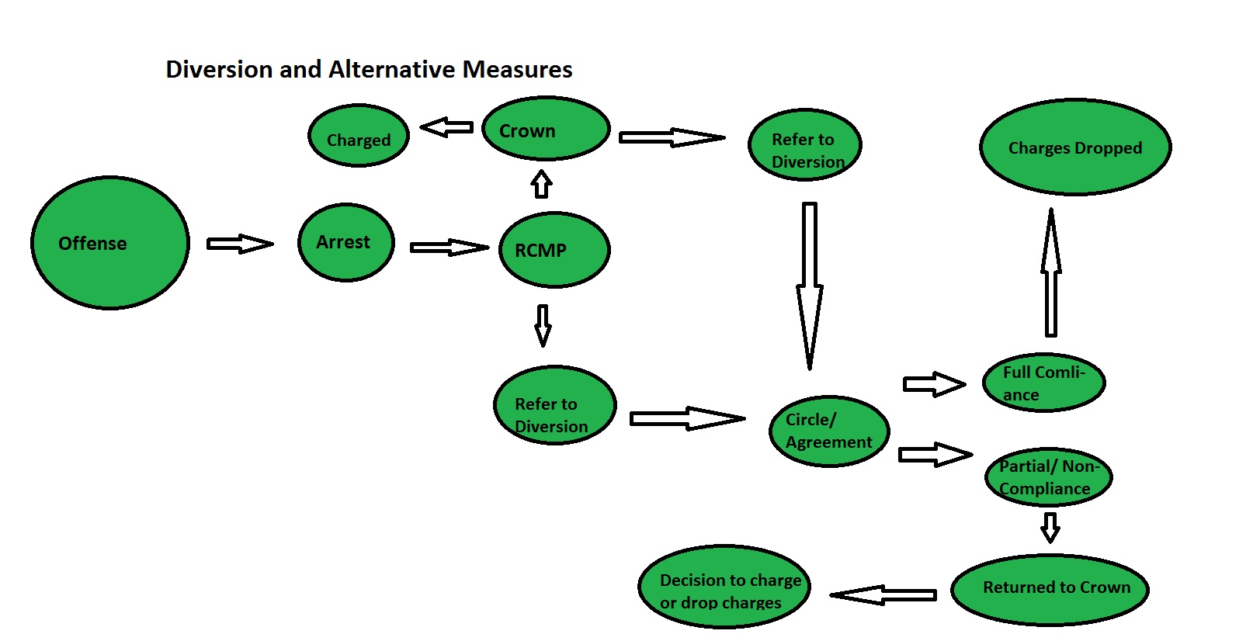

Slide 5
The Aboriginal Justice Strategy
The Aboriginal Justice Strategy (AJS) supports Aboriginal community-based justice programs that offer alternatives to mainstream justice processes in appropriate circumstances
Objectives:
To contribute to a decrease in the rates of victimization , crime and incarceration among Aboriginal people in communities with AJS programs
To assist Aboriginal people in assuming greater responsibility for the administration of justice in their communities
To provide better and more timely information about community-based justice programs funded by the AJS
To reflect and include Aboriginal values within the justice system
    Department of Justice Canada

Slide 6
Why is there a need for Aboriginal justice programs?
According to the 2006 Census, 3.1% of adults 18 years or older in Canada self-identified themselves as Aboriginal
In 2007/2008, Aboriginal adults accounted for 17% of adults admitted to remand, 18% admitted to provincial/territorial custody, 16% admitted to probation and 19% admitted to a conditional sentence.
From 1998/1999 to 2007/2008, Aboriginal adult representation has increased from 13% to 18%
                Stats Canada
*** This doesn’t include those who have not identified as Aboriginal, and also does not include Aboriginal Youth. In addition, these stats do not encompass Federal offenders, institutions, and/or programs ***

Slide 7
Cont’d
To bring it much closer to home, it is estimated that there are currently 254 inmates at Prince George Regional Correctional Centre (PGRCC) and of those inmates, approximately 65% are identified as Aboriginal
This number may also vary, given not everyone may self-identify
This means roughly 165 of the 254 inmates are Aboriginal…
We need to continue to educate ourselves on the effects of intergenerational trauma, poverty and violence, as a result from residential schools, assimilation and colonization. This will be arguably one of the most important steps in working towards ending this epidemic that continues to plague our Aboriginal People.
Knowledge will provide compassion and greater services to our relatives

Slide 8
Services
Youth and adult Diversion:
  Alternative Measures and Extrajudicial Sanctions (EJS)
  Healing Circles
Case Management – Identifying barriers:
  housing support, employment training referrals, connecting with cultural/spiritual supports, referrals for counselling and other support services
Legal Services Partner:
  Computer available in office for client use – information on legal aid, etc.
  Provide clients with support to the local legal aid office and/or Native Court workers

Slide 9
Services Cont’d
Deliver “Respectful Relationships”
  In collaboration with Community Corrections and PGRCC
  Offer our services post-group to support client needs
Educational workshops and presentations
  As part of a recent RCMP Family Violence initiative, our agency has and will continue to work with SD57 to address family violence which includes:
    Respectful Relationships, Gang Violence, Trauma, Sexual Exploitation, and Drug Awareness.

Slide 10
Referring agencies
RCMP
Community Policing
Crown Counsel
Community Corrections
Correctional Institutions
School District
MCFD
Self
Band and Council
Community and other service agencies

Slide 11
Community partnership and collaboration
Instrumental in the work we do!
Our agency strives to collaborate as much as possible with other community partners, which includes, but not limited to:
    Weekly case management meetings at Community Corrections
    Weekly visits to PGRCC
    Integrated Case Management with MCFD, SD57, Probation, RCMP
    Our agency sits on various committees:
      HIP (Homeless Intervention Project)
      CASEY (Communities Against Sexual Exploitation of Youth)
      Youth Service Gathering (Youth Around Prince George)

Slide 12
Building Capacity – “2016 Community Capacity Conference for Northern Aboriginal Justice Workers”

Slide 13
Respectful Relationships
Respectful Relationships - part one is a 10-session program that teaches offenders how to manage their emotions and behaviour and increases their problem-solving skills so they are less likely to be violent in their relationships.
Relationship Violence - Part Two is a 17-session program for men who assault their partners.
          Government of British Columbia
We co-facilitate part one with Probation Officers and/or Correctional Officers, part two is facilitated by clinical counsellors
Helps to bridge the relationship between government and community and assists in connecting clients to community service agencies
“Thoughts lead to behaviour.” ABCDE Model →
  A – Actions (Out of our control) B – Beliefs (In our control) C – Consequences (In our Control) D – Decisions (In our Control) E – Effect (Out of our control)

Slide 14
Funders
Department of Justice Canada (Federal Funder)
Ministry of Attorney General (Provincial Funder)
Ministry of Public Safety and Solicitor General (Provincial Funder)
Ministry of Child and Family Development (Provincial Funder)
Indigenous Services Canada
The Law Foundation
Justice Education Society
Vancouver Foundation

Slide 15
THANK YOU!
Questions or Comments?

